Slide 1

Depression Indicator Prediction
Using NHANES 2017-MAR 2020 & 2021-2023 Data
Group 3: Angela Johnson, Annabel Tapia, Naeem Chaudhry, Thiri Kyi

Slide 2

Background
Depression is a common mental health condition, it affects mood, energy, sleep, and daily functioning for weeks or longer.
It can seriously impact physical health, relationships, work, and overall quality of life.
Doctors and researchers screen for it using standardized questionnaires, our project uses one of the most common ones, the PHQ-9.

Slide 3

OUR GOAL
Explore whether everyday health and lifestyle information can help flag higher depression risk.

Slide 4
Why it matters
13.1%
of U.S. adolescents & adults
screened positive for depression
(CDC, NHANES 2021–2023)
60%
increase in depression
prevalence over the past decade
(CDC, released 2025)
Depression is common, disabling, and treatable, but many cases go unnoticed.
Spotting patterns in everyday health and lifestyle data could support earlier screening conversations.
This is a chance for our team to apply real machine learning skills to a meaningful public health question.

Slide 5
THE dATASET

Slide 6
Dataset and prediction
Source: NHANES, combining two cycles 2017-March 2020 (pre-pandemic) and 2021–2023 (post-pandemic) for a larger robust sample
Target: a Depression Flag, built from the PHQ-9 (9 standard screening questions)
Score of 10 or higher → flagged as likely depression. Below that, not flagged.
13,731
people with a usable
PHQ-9 score
10.9%
flagged for likely
depression (1,490 people)
The 2021-2023 slice alone (13.3%) closely matches CDC’s national estimate for that period (13.1%) and the rise from the pre-pandemic cycle (9.3%) mirrors CDC’s reported decade-long increase.

Slide 7



Quote
What we are using to predict
DEMOGRAPHICS
Age, gender
Education
Marital status
Born in the US
LIFESTYLE
Sleep hours (weekday/weekend)
Physical activity minutes
Smoking and alcohol use
HIV testing history
INCOME
Income-to-poverty ratio
Monthly poverty index
Family income category

Slide 8
GETTING THE DATA READY
Raw survey data uses special codes for “Refused” and “Don’t know”, we have converted those to real missing values
Combined two separate NHANES survey cycles into one consistent table on a shared set of columns
Filled in the small number of remaining gaps so that every row was complete
BEFORE:
27,493
people across two survey cycles
AFTER:
13,731
people across two survey cycles
BEFORE:
116-118
raw columns
AFTER:
28
clean columns, 0 missing

Slide 9
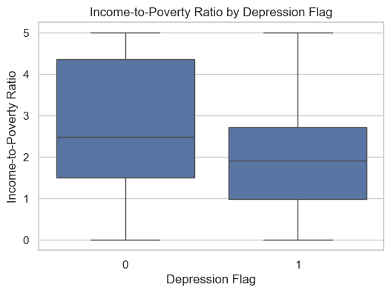
Early patterns
WHAT STANDS OUT:
• Participants flagged for depression tended to have lower income-to-poverty ratios.
• The average was 2.13 for the flagged group, compared with 2.79 for the group not flagged.
• The overlap shows that income is only one part of depression risk.

Slide 10
Implementation and tools
Core stack
Python, Jupyter Notebook
Pandas, NumPy
GitHub for version control
Matplotlib
Modeling Libraries
Scikit-learn (Logistic Regression, SVM, RF)
CatBoost, XGBoost
All libraries are third-party (open source)

Slide 11
Quote
What we are using to predict
We are framing this binary classification: predict Depression_Flag (0 or 1) from the cleaned features
Everyone trains and tests on the exact same data split giving us results that are comparable
Only ~11% of cases are flagged; we are addressing this class imbalance rather than relying on plain accuracy
CatBoost
Angela Johnson
Random Forest & Logistic Regression
Thiri Kyi
SVM
Naeem Chaudhry
XGBoost
Annabel Tapia

Slide 12
Results
Model | Accuracy | Precision | Recall | F1-score
CatBoost | 0.7573 | 0.2257 | 0.4638 | 0.3036
Random Forest | 0.7920 | 0.2232 | 0.3277 | 0.2655
Logistic Regression | 0.7820 | 0.2415 | 0.4255 | 0.3082
SVM | 0.7864 | 0.2577 | 0.4638 | 0.3313
XGBoost | 0.7723 | 0.2365 | 0.4468 | 0.3093

Slide 13
Live demo

Slide 14

Conclusion
ACCOMPLISHMENTS:
Built a full reproducible cleaning pipeline that combines two NHANES cycles into one model-read dataset
Our data’s rate (13.3% post-pandemic vs 9.3 pre-pandemic) echoes CDC’s own reported national trend
Checked whether our top model changed depending on the metric used and reported it honestly instead of picking whichever looked best
Verified all five models were compared fairly, with no data leakage in any of them
CHALLENGES:
Five of our originally planned predictors BMI, employment, general health, chronic disease history, and healthcare access were never available in the NHANES files we could access, limiting how complete a risk picture any model could build
With only ~11% of respondents flagged, every model struggled with low precision (0.23–0.26) expected when predicting a rare outcome from general survey data, but it meant accuracy alone would have been a misleading way to judge success
Keeping five separate notebooks (one per model, built independently) consistent same feature set, same leakage checks, same train/test discipline took real coordination across the team

Slide 15

Thank you

